Slide 1

Data Wizards: eCommerce Platform
Team Data Wizards, a group of 3rd Year Engineering students, presents an eCommerce platform project focused on Discount and Coupon Management. Our team members, Nandan(se22uari110), Vishal(se22uari126), Vandana(se22uari202), and Sidharth(se22uari160), have come together to showcase our expertise in Object-Oriented Programming (OOP) concepts and their practical application in building a robust and scalable eCommerce solution.
page1

Slide 2
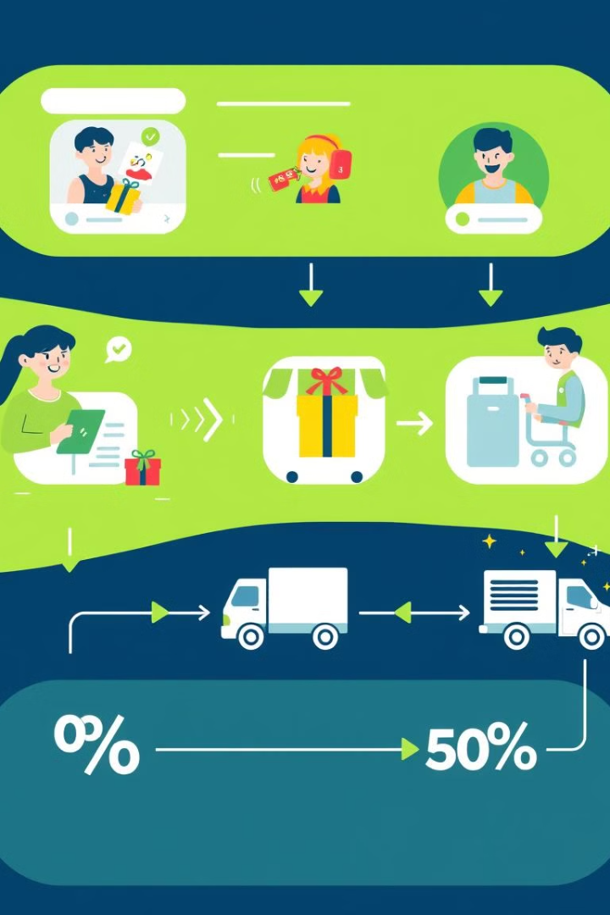
Project Overview
1
Key Objectives
2
OOP Principles
Our eCommerce platform aims to provide efficient management of discount policies, dynamic coupon application for users, and the incorporation of fundamental OOP principles.
We have designed our platform to leverage the power of OOP concepts, enabling flexible, scalable, and maintainable discount and coupon management functionality.
3
Platform Features
Our eCommerce platform offers a comprehensive solution for managing discounts and coupons, empowering businesses to create and apply various discount types, validate coupons, and provide personalized offers to customers.
page2

Slide 3
OOP Concepts Used
Encapsulation
Inheritance
Polymorphism
Wrapping data (fields) and methods into a single unit (class) and restricting access to the internals of the object.
A class (subclass) inherits the properties and behaviors of another class (superclass).
The ability of a method or object to take many forms.
Example: Method overloading (compile-time) and method overriding (runtime).
Example: Declaring variables as private and providing public getter and setter methods.
Example: class DiscountedProduct extends Product.
Use in Project: Use method overriding in classes like Coupon or Discount. For example, override a calculateDiscount() method differently for flat discounts vs percentage discounts.
Use in Project: Create a base Product class. Specialized classes like DiscountedProduct or SeasonalProduct can inherit and reuse the common properties like productName, price.
Use in Project: In your Coupon and Discount classes, encapsulate fields like discountPercentage or couponCode. Use setters and getters to modify or access these fields securely.
Page3

Slide 4
OOP Concepts Used
Abstraction
Dynamic Binding
Message Passing
Hiding implementation details and showing only the essential features.
The code to be executed for a method call is determined at runtime.
Objects communicate with each other by invoking methods and passing data.
Example: Using abstract classes or interfaces.
Use in Project: If you have a list of Discount objects, calling applyDiscount() will invoke the appropriate method implementation at runtime, depending on the actual object type.
Use in Project: The Cart object may call methods in Product, Coupon, and Discount classes to calculate the total price after applying discounts.
Use in Project: Create an abstract class Discount with an abstract method applyDiscount(). Subclasses like PercentageDiscount and FlatDiscount will provide specific implementations.
page4

Slide 5
OOP Concepts used
This()
Class
Object
Refers to the current instance of the class. It is used to differentiate between class attributes and parameters.
A blueprint for creating objects. It defines properties and methods.
An instance of a class that contains actual values for properties and can invoke methods.
Use in Project: Define classes such as Product, Customer, Order, Coupon, and Discount to model the eCommerce platform.
Use in Project: Create objects like Product product1 = new Product("Laptop", 1000); or Coupon coupon1 = new Coupon("SAVE20", 20);.
Use in Project: In constructors of Product, Coupon, or Discount, use this to assign parameter values to instance variables.
Page5

Slide 6
User Interface (UI) Using Swing in Java
Key Features of Swing
Common Swing Components
How Swing Fits in the eCommerce Project
Lightweight Components: Independent of native system resources (unlike AWT).
JFrame: Main window.
Purpose: Build an intuitive UI for the eCommerce platform.
JPanel: Container to organize components.
Platform Independence: Runs consistently across all operating systems.
Example Use: JFrame for the main window (e.g., "Shop Dashboard"). JTable to list products. JButton for actions like "Apply Coupon" or "Checkout". JTextField to enter coupon codes.
JLabel: Display text/images.
JButton: Clickable button.
Pluggable Look-and-Feel: Customize the UI’s appearance.
JTextField: Editable text input.
MVC Architecture: Separates data (Model), UI (View), and behavior (Controller).
JTable: Tabular data display.
Page6

Slide 7
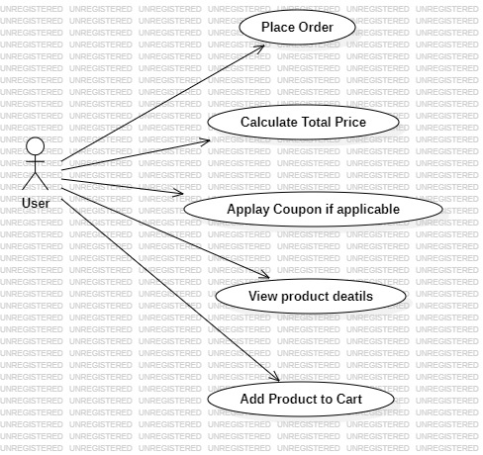
Use Case Diagram
Explanation of Use Cases:
1.Place Order: The User can initiate an order by placing items in the cart and proceeding with a purchase.
2.Calculate Total Price: The system calculates the total price of items in the cart when the user places an order.
3.Apply Coupon if Eligible: If a coupon is available, the system checks eligibility based on minimum order requirements and applies a discount if applicable.
4.View Product Details: The User can view details of a product, such as the name, description, and price.
5.Add Product to Cart: The User can add selected products to the shopping cart with specified quantities.
6.Connect to Database: The system connects to the database to store and retrieve relevant data related to users, products, orders, and inventory.
page7

Slide 8
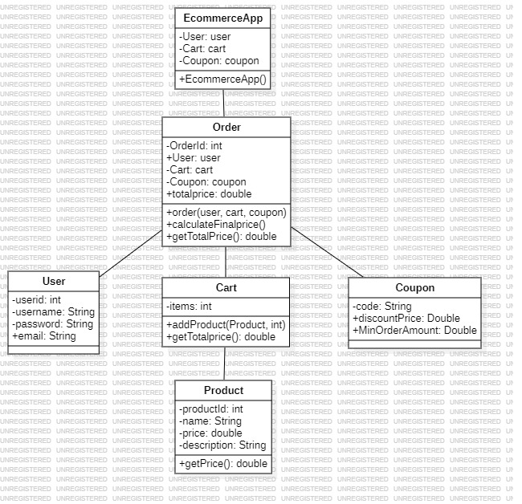
Class Diagram
Explanation:
1.ECommerceApp: It is the main class (a JFrame) that creates instances of User, Cart, Product, and Coupon and initializes the application's UI.
2.Order: It aggregates User, Cart, and Coupon to place an order.
3.User: Holds the user data.
4.Cart: Contains a collection of Product objects with their quantities and calculates the total price of items.
5.Coupon: Defines a discount coupon that applies a discount if certain conditions are met.
6.Product: Represents a product with attributes such as ID, name, price, and description.
7.DatabaseConnection: Provides a static method to connect to a database.
Relationships:
Aggregation: Order aggregates User, Cart, and Coupon.
Association: ECommerceApp uses User, Cart, and Coupon.
Composition: Cart has a composition relationship with Product, as Product instances are added directly to Cart.
page8

Slide 9
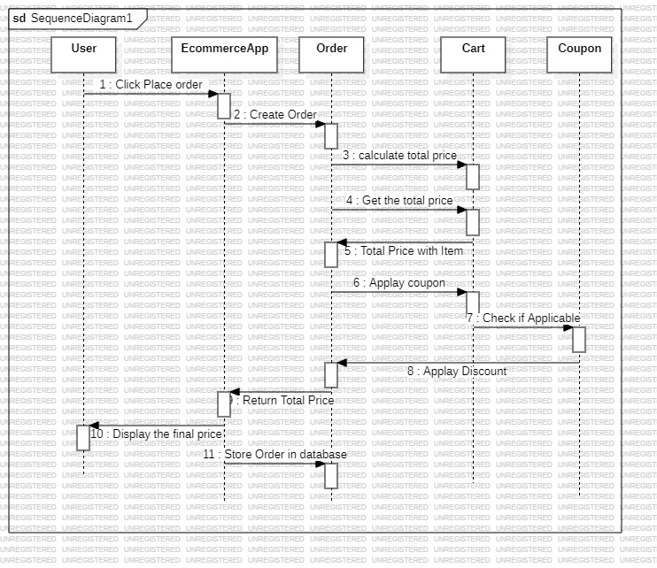
Sequence Diagram
Explanation of steps:
1.Click Place Order: The User initiates the order by clicking the "Place Order" button.
Create Order: The ECommerceApp creates a new Order object.
Calculate Total Price: Order requests the total price from the Cart.
gettotalprice: The Cart calculates the total price of items.
Apply Coupon: If a Coupon is present, Order checks if the coupon is applicable.
Check if applicable: The Coupon class verifies if the order amount meets the minimum requirement.
Apply Discount: If applicable, the discount is applied to the total price.
Return Final Price: The discounted price is returned to the Order.
Display Final Price: ECommerceApp displays the final price to the User.
Store Order in Database: ECommerceApp saves the order details to the database.
Connect to Database: DatabaseConnection establishes a connection to store the order data.
page9

Slide 10
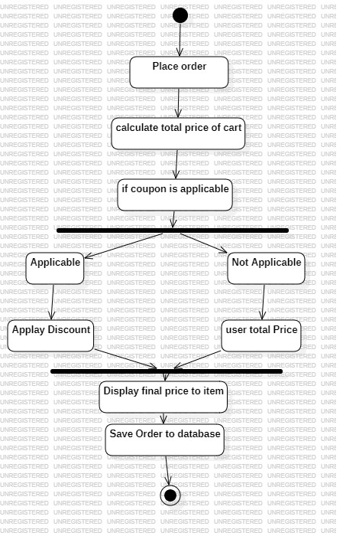
Activity Diagram
Explanation of Activities:
Start: The process begins when the user initiates the order by clicking the "Place Order" button.
Create Order Object: The ECommerceApp creates an Order instance.
Calculate Total Price: The application calculates the total price of the cart items.
Check if Coupon is Applicable: The application checks if any available coupon is applicable based on the cart’s total price.
If Applicable: If the coupon meets the minimum order amount, it applies the discount to the total price.
If Not Applicable: If the coupon does not meet the requirements, it skips the discount and uses the total price.
Display Final Price to User: The application displays the final (discounted or regular) total price to the user.
Save Order to Database: If applicable, the application saves the order details to the database.
End: The "Place Order" activity concludes.
page10

Slide 11
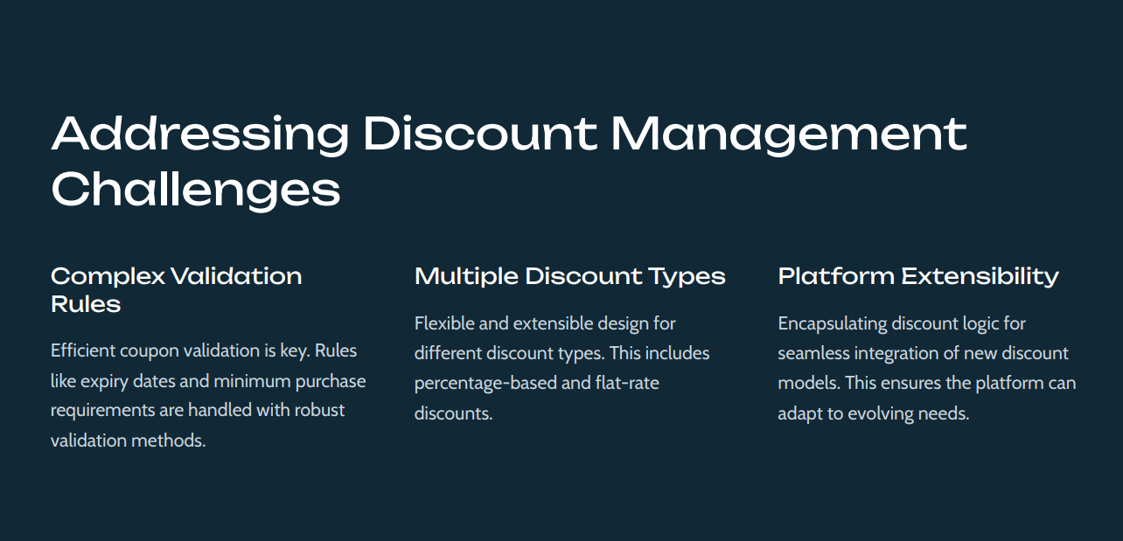
*Forward engineering
*Backward engineering
page11

